Slide 1
Soccer DB
COMP-520 Sec 001 - Advanced Database Systems
May 8, 2019
Vasanthi Lingamdinne,
Niranjan pawar
Prof. Brian Thoms

Slide 2
DESIGN

Slide 3
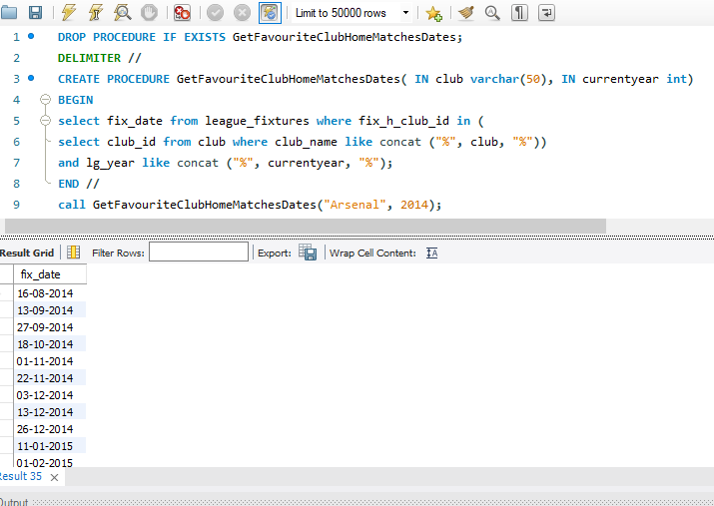
HOME MATCHES THAT YOU SHOULDN’T MISS

Slide 4
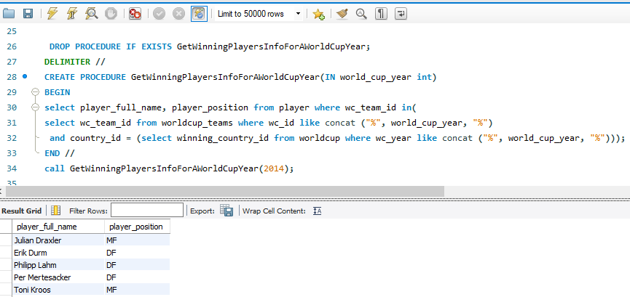
WORLD CUP WINNERS

Slide 5
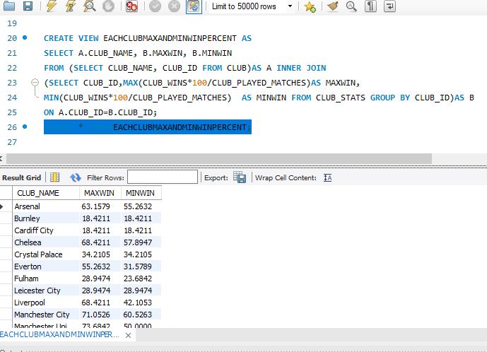
HOW GOOD YOUR CLUB IS?

Slide 6
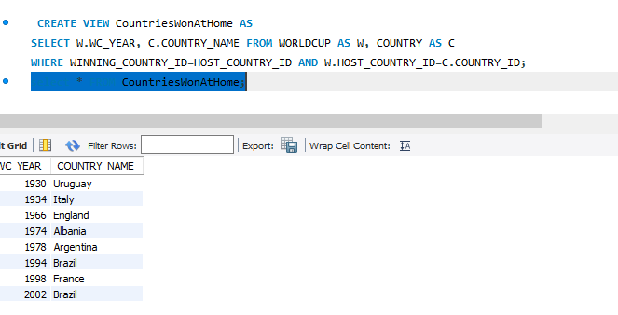
WINNING WORLD CUP AT YOUR HOME!!!

Slide 7
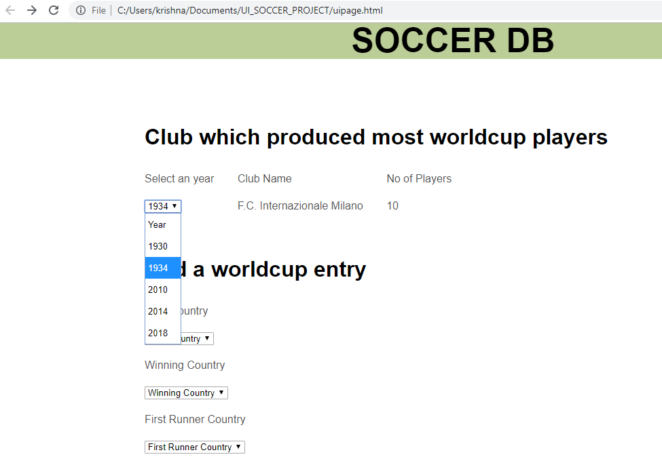
User Interface

Slide 8
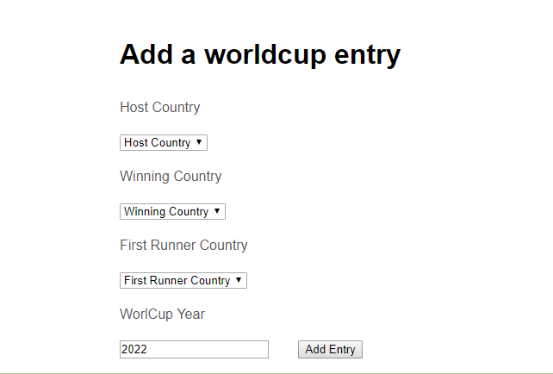
User Interface

Slide 9
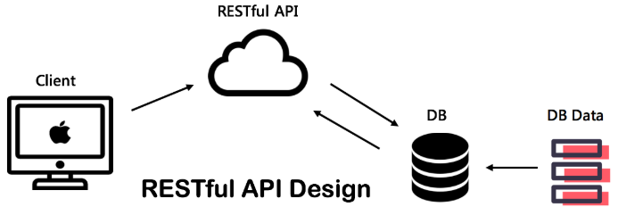
Web Services - Development environment
Server:
IDE: Eclipse IDE for JEE (v7+)
Java SE7
Web container: Apache TomEE 8.0
Jersey libraries:
Client:
HTML5 and JavaScript

Slide 10
Architecture
Client
HTML5 Web Browser
Ajax Request
Web Service Running on Apache Tomee
Restful API
JDBC Driver
mySql

Slide 11
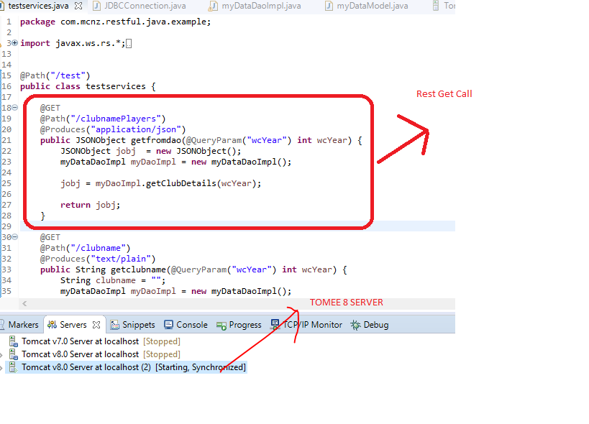
RESTful Web service

Slide 12
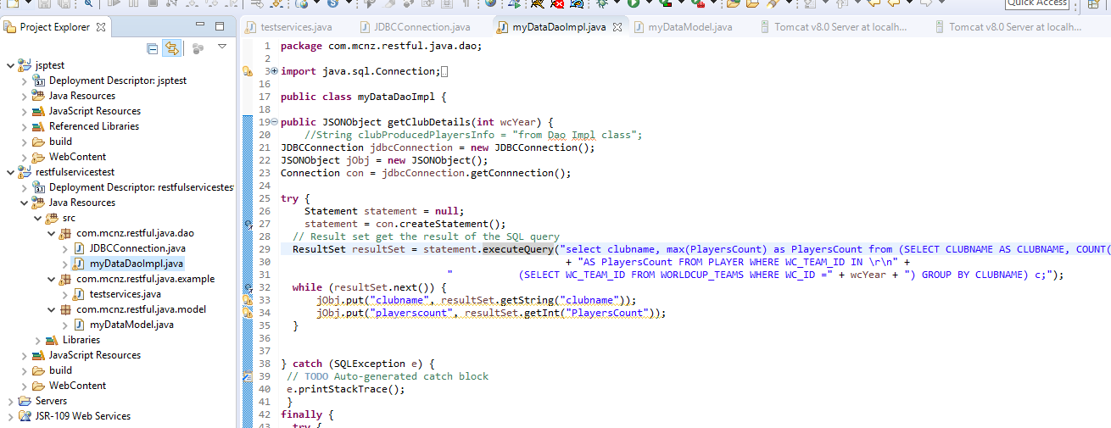
DataModel for JDBC Connection

Slide 13
Potential use cases
Fans
Manager/Coach
Club Management
Countries
Investors
Sponsorship
Tv Adds
Stadiums

Slide 14
Thank you

